Slide 1


Market Frontier
Global Business
Opportunities for Korean Companies in Key Sectors
November 2023
KPMG Korea, ERI (Economic Research Institute)

Slide 2
Contents
I. | The Era of Great Transformation: Changes in the Business Environment
II. | Global Business Opportunities in Key Sectors
III. | Key takeaways

Slide 3
I.
The Era of Great Transformation: Changes in the Business Environment

Slide 4
‘Sticky Inflation’ persists
In an era of high interest rates
Dollar’s resurgence
I. The Era of Great Transformation: Changes in the Business Environment
1. Continued uncertainty – sticky inflation, high interest rates, increased currency volatility
CPI fell steadily in response to interest rate hikes, but began rising again in July 2023
Fed signals additional rate hikes to come in 2023 as inflation remains high. Korea faces increasing pressure to raise interest rates in line with the U.S.
The dollar index has been steadily increasing since July 2023, leading to a 4.4% depreciation of the won against the dollar in the past two months
(%, YoY)
(%, YoY)
(1973.3=100)
U.S. Dollar Index
Currency fluctuations relative to the US dollar over the past two months
(%)
3.7
3.7
EU
China
Japan
Brazil
Mexico
South Korea
United Kingdom
Russia
Source: OECD
Source: FRED, BOK
Source: BOK, Investing.com
Note: 9 Oct. 2023

Slide 5




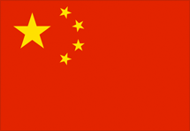

I. The Era of Great Transformation: Changes in the Business Environment
2. High risk of economic downturn – Economy held up well in ‘23, but there is also an increasing risk of slowdown
IMF Economic Forecast
2023 Economic Growth Forecast
(April 2023 vs. October 2023)
2024 Economic Growth Forecast
(April 2023 vs. October 2023)
2.8%
3.0%
3.0%
2.9%
Global
▶
▶
1.6%
2.1%
1.1%
1.5%
U.S.
▶
▶
0.8%
0.7%
1.4%
1.2%
Eurozone
▶
▶
5.2%
5.0%
4.5%
4.2%
China
▶
▶
1.5%
1.4%
2.4%
2.2%
Korea
▶
▶
1.3%
1.5%
1.4%
1.4%
Advanced countries
▶
▶
3.9%
4.0%
4.2%
4.0%
Developing countries
▶
▶
Source: IMF, World Economic Outlook

Slide 6
Trends in Korea’s export, import, and trade balance
Trends in Korea’s overseas direct investment
I. The Era of Great Transformation: Changes in the Business Environment
3. Korean companies seeking new growth drivers
Concerns over the Korean economy grew as it experienced a 15-month streak of trade deficits from March 2022. The trade balance shifted to a surplus in June 2023, but this was due to imports outpacing exports, which is a sign of a potential recession
South Korea’s overseas direct investment, to secure growth drivers for domestic companies, continued to grow steadily. It set a new annual record high in 2022
(100 Million Dollar)
(100 Million Dollar)
Source: BOK
Source: Ministry of Economy and Finance

Slide 7
II.
Global Business Opportunities in Key Sectors
Financial Services Consumer & Retail Technology, Media & Telecommunications Infrastructure, Government & Healthcare Industrial Markets

Slide 8



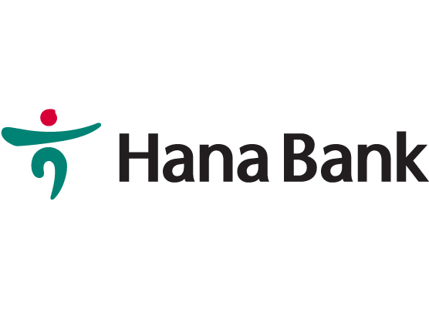
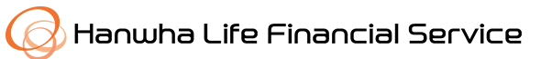

II. Global Business Opportunities in Key Sectors
FS Industry: Major Issues & Sectors for Overseas Expansion
01
02
03
Retail Banking
Insurance
Payments
The total assets of overseas branches recorded a visible increase, rising by 10.9% year-over-year to $203.14B in 2022
The net profit ratio of overseas business increased to an average of 14%
As the domestic market becomes saturated, Korean Insurers are actively expanding into Asia-Pacific markets
As of Dec. 2022, the net profit of 36 overseas branches recorded $122.5M, marking a 34.9% increase from the previous year
Increased payment integrations through global partnerships will improve user convenience
Expanding global reach to attract users to other financial services on its platform
In July 2023, KB obtained a license to establish a consolidated commercial bank by merging its overseas subsidiaries, Prasac Microfinance and KB Bank Cambodia
Acquired a 37.32% stake in PTI Insurance in 2015 and signed deal to acquire a 75% stake in VNI Insurance and a 75% stake in BSH Insurance in 2023
Support Global payment services, including PayPal and Alipay, for Korean customers residing overseas
In August 2023, Hana signed an MOU with the State Bank of India to collaborate on global expansion, including the potential opening of two additional branches in India
In March 2023, Hanwha acquired a 62.6% stake in Lippo General Insurance, the financial subsidiary of Indonesia's sixth-largest conglomerate, the Lippo Group
In partnership with UnionPay and Alipay, new QR code payment service was launched in China and Japan in September 2023
Source: Press reports, Samjong KPMG Economic Research Institute

Slide 9


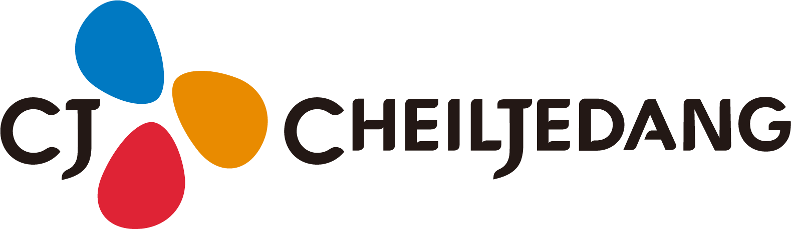


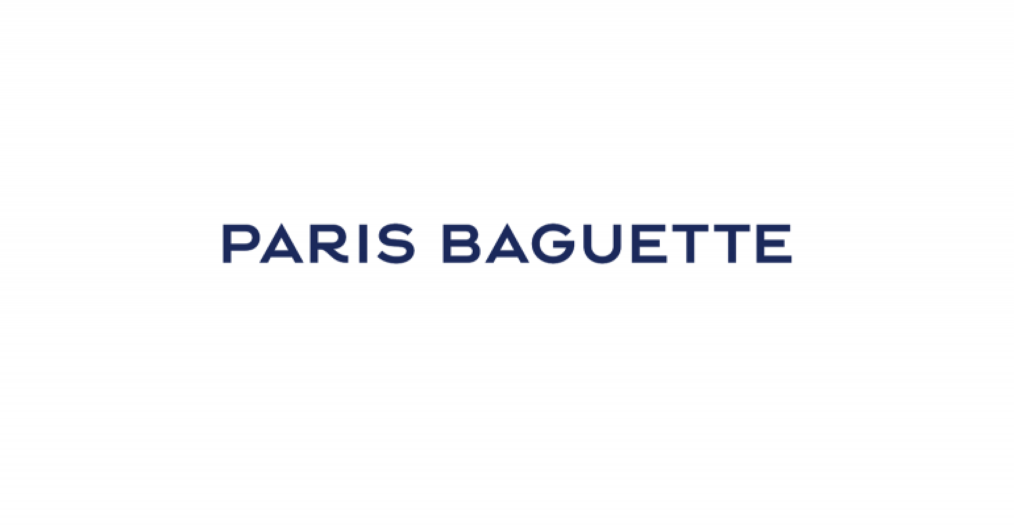

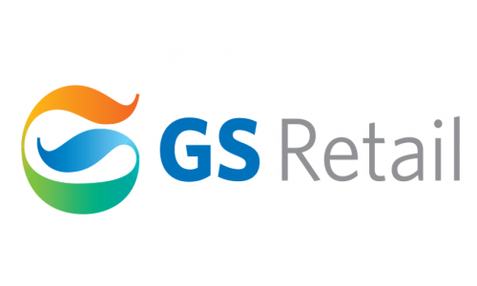






II. Global Business Opportunities in Key Sectors
C&R Industry: Major Issues & Sectors for Overseas Expansion
01
02
03
04
Convenience Stores
HMR·Street Foods
Bakeries
Casual Fashion
As K-culture spreads worldwide, Korean convenience stores are rapidly expanding to global markets
Top 3 brands operate over 900 stores in Vietnam, Mongolia, and other countries, and plans to open more than 1,000 stores this year
Exports of Korean HMR (Home Meal Replacements) surged more than 3.2 times in 2022 compared to the previous year
Exports of K-street foods (e.g. Corndog·Frozen mandu·Tteokbokki) increased at a CAGR of 22.3% from ’18 to ’22
Korean bakery franchises captivate global consumers by offering an extensive selection of over 300 products in a single store
Actively promoting Korean bakery culture globally, including the U.S., Europe, and Asia
Korean fashion brands expand their global presence to meet the increasing demands of millennials and Gen Z consumers for street and retro-inspired casual fashion
Companies establish licensing agreements with local firms or utilize online platforms for global expansion
FILA is gaining traction in China, expanding its brand presence, with about 80% of its sales coming from the international market in 2022
CU, a leading player in Mongolia, holds a substantial about 70% of the M/S
CJ introduces “K-Street Food,” a strategic move in its ambitious global expansion plan
In 2022, sales in the U.S. surged to $400B. SPC is actively pursuing global expansion initiatives in North America and other regions
Nerdy’s sales have grown at CAGR of 67%(’18-’22) driven by active overseas expansion. In 2022, int’l sales account for approximately 40% of its total sales
GS25, takes the lead in the M/S in Southern Vietnam, surpassing the U.S. and Japanese convenience store competitors
Pulmuone ventures into the U.S. and other global markets with its plant-based ready meals
CJ Foodville invests more than $37M in the construction of a bakery plant in the U.S.
Source: Press reports, Samjong KPMG Economic Research Institute

Slide 10




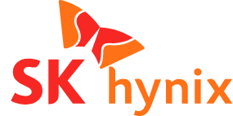

II. Global Business Opportunities in Key Sectors
TMT Industry: Major Issues & Sectors for Overseas Expansion
01
01
02
03
Advanced Semiconductor
Automotive Display
Webtoon Platforms
Exports of HBM (High Bandwidth Memory)-based high-performance memory is expected to experience strong growth in 2023
Korean companies are ramping up the production of DDR5 products to meet the growing demand for high-performance DRAM in the AI market
In 2022, South Korean companies held a leading 92.7% of the M/S in the global automotive OLED market
Proportion of OLED in the Automotive Display Market is expected to increase from 2.8% in 2022 to 17.2% in 2027
Innovative technologies such as slidable and rollable automotive displays are new areas of focus
Demand for webtoons is increasing among Gen Z globally, with 40% of Korean webtoon exports originating from Japan and 22% from North America (as of 2021)
The success of dramas and movies based on webtoons has highlighted the scalability and growth potential of webtoons
In the first half of 2023, Amazon and Apple also introduced webtoon services
Leveraging its significant DRAM process capabilities, Samsung developed largest capacity DRAM in 2023, ‘32Gb DDR5 DRAM’
Reached No.1 in sales in the automotive display market (larger than 10 inches)
Developing new products using new technologies such as a pillar-to-pillar display
Acquired global webtoon/web novel platforms to strengthen its market power
Completed the development of HBM3 in 2021 and supplied it to Nvidia. Developed HBM3E in 2023
Acquired webtoon and web novel platforms in North America
Diversified the use of famous webtoon IPs
Unveiled the multi-foldable display 'Flex S’, which is available both inside and outside of the vehicle
Source: Press reports, Samjong KPMG Economic Research Institute

Slide 11




II. Global Business Opportunities in Key Sectors
IGH Industry: Major Issues & Sectors for Overseas Expansion
01
02
03
Sustainable Shipping
AI Medical Imaging
AI Waste Management
Increasing demand for alternative fuels in shipping to comply with decarbonization regulations
Korean shipbuilding companies held the global-leading position with advanced technology
AI-enabled medical imaging solutions have enhanced accuracy by over 80% and expedited diagnoses
Korean AI medical imaging companies are actively expanding into the global market
The global waste market was valued at $1.6 trillion in 2020 and is expected to reach $2.5 trillion by 2030
ICTs, such as IoT, big data and AI, are being integrated to enhance waste management system
Secured over 50% of global orders for methanol-powered ships
Delivered world’s first methanol-fueled container ship to Maersk in Sep. 2023
Won FDA approval for AI-based brain imaging analysis medical device.
'Lung CT AI' is distributed in Japan
Supplied AI-based solution to optimize incinerator operations to “Cenviro,” Malaysia’s largest public integrated waste management company
Provided “ZERO4 WtE Solution” to “Green Star,” a Vietnamese industrial waste treatment company
'Lunit INSIGHT', the AI solution has been adopted by over 2,000 healthcare institutions worldwide
Overseas market accounted for 85.5% of Lunit’s total sales in the first half of 2023
Established 'The Castor Initiative' to promote ammonia-powered shipping
Source: Press reports, Samjong KPMG Economic Research Institute

Slide 12





II. Global Business Opportunities in Key Sectors
IM Industry: Major Issues & Sectors for Overseas Expansion
01
02
03
Cathode Materials for Battery
EV Fast Charger
Biosimilar
The U.S. IRA spurs expansion of Korean battery makers in the U.S.
Cathode materials manufacturers frequently accompany battery cell makers in their overseas expansion to ensure a stable supply of materials
The charging Infrastructure market is projected to expand at a CAGR of 27% from 2021 to 2030
The U.S. is going to provide financial assistance for fast EV charge (faster than 150kW) starting in July 2024
The biosimilar market grew at a CAGR of 53.4% from 2016 to 2021
The market size is expected to reach $74B by 2030, driven by favorable policies and the expiration of patents on blockbuster drug
LG Chem is set to construct a cathode materials plant in Tennessee, the U.S., with plans for commencing mass production in 2025
Ultra-fast charger factory in Texas, the U.S. is expanding to produce over 10,000 units per year
In February 2023, SK signet entered the EU EV charging market, starting with Germany, the UK, Italy, France, and Spain. In the UK, the company signed a contract worth 10B won
Samsung Biologics introduced Byooviz, a biosimilar of Lucentis, and secured over 10% of the M/S within 3 months, expanding into Germany, Canada, and other countries
EcoPro BM plans to build a cathode materials plant in Quebec, Canada, and produce 45,000 tons of cathode materials annually, starting in 2026
A biosimilar of rituximab was launched in EU and secured over 30% of the M/S within a year
Source: Press reports, Samjong KPMG Economic Research Institute

Slide 13
III.
Key Takeaways

Slide 14

III. Key Takeaways
Strategies for Key Opportunities
Business Strategies in New Reality
Diversify the global expansion strategy to overcome the limitations of domestic market
01
ESG(Environmental, Social and Governance) Strengthening non-financial value using ESG strategy
and disclosure
Utilize technology in daily life
Integrate technologies into everyday life
Enhance new technologies to innovate unstructured tasks
Develop AI-driven transformation strategies
Identify and develop new upstream and downstream connections to support overseas expansion goals (e.g., Since 2023, banks and insurers can now establish non-financial subsidiaries abroad)
02
Overcoming Deglobalization Diversify export/import routes and supply chains. Be responsive to international conflicts
03
Customer Experience Be proactive about understanding customer needs
and foster customer-centric culture
Emergence of new consumers
ESG, a key for business
Gen Z and Gen Alpha are emerging as the primary consumers in the market
Develop strategies to enhance consumer 'mind share’ (e.g., combining K-culture and consumer goods)
The growing importance of ESG will impact the global expansion of Korean corporations
Seize the opportunities created by ESG and IRA policy changes related to net zero
04
Digital Transformation Enhance DT strategies with hyper-scale AI and ICTs
Source: Samjong KPMG Economic Research Institute

Slide 15
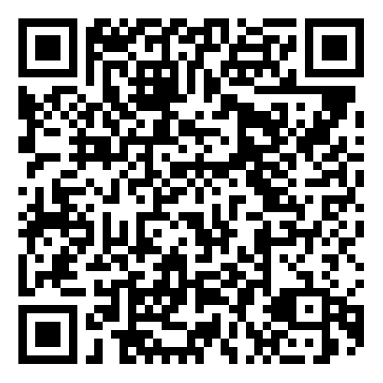
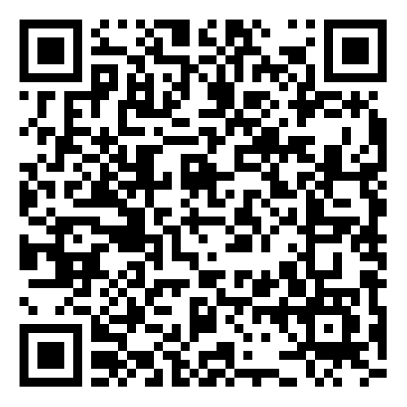
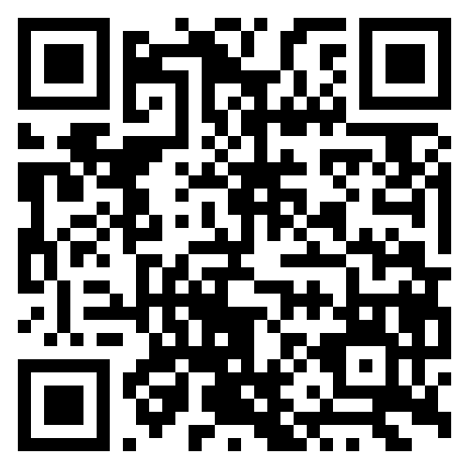
Contact us
Who to contact?
Chris (Kyongchoul) Shin Head of GKP, Partner
T +82 2112 0788 E kshin@kr.kpmg.com
Cklio (Yunseob) Lee Overall, Principal
T +82 2112 0169 E yunseoblee@kr.kpmg.com
Jenny (Hyojung) Lee TMT, Senior Director
T +82 2112 6744 E hyojunglee@kr.kpmg.com
Dowhi Park IGH, Senior Manager
T +82 2112 0904 E dohwipark@kr.kpmg.com
Narae Kim IM, Senior Manager
T +82 2112 7095 E nkim15@kr.kpmg.com
Sookyung Kim C&R, Senior Manager
T +82 2112 3973 E sookyungkim@kr.kpmg.com
Yeonkyung Choi FS, Manager
T +82 2112 7769 E yeonkyungchoi@kr.kpmg.com
How to contact?
KPMG Korea Homepage
KPMG Korea YouTube

